Slide 1

CEF 345 : SOFTWARE DEVELOPMENT TOOLS
PRESENTED BY GROUP 24
TAKU-MBI INYANG FE23A153
TAMANTENG ABERLINE NGUEMTANG FE23A154
TAMBE ENOWTABI PRINCELY FE23A155
TAMBE RAMSON NGIEH FE23A156
TAMBONG ELVIRA ETCHI FE23A158
SUPERVISED BY : Dr NKEMENI VALERY

Slide 2
BUILDING OF THE CODE
PUSHING THE CODE INTO A GIT BRANCH
SAVING AND DEPLOYMENT

Slide 3
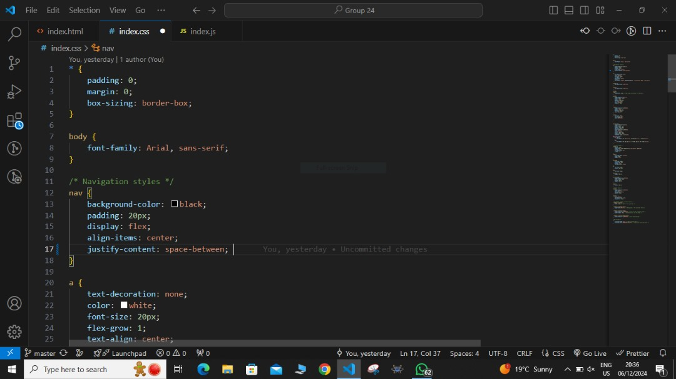
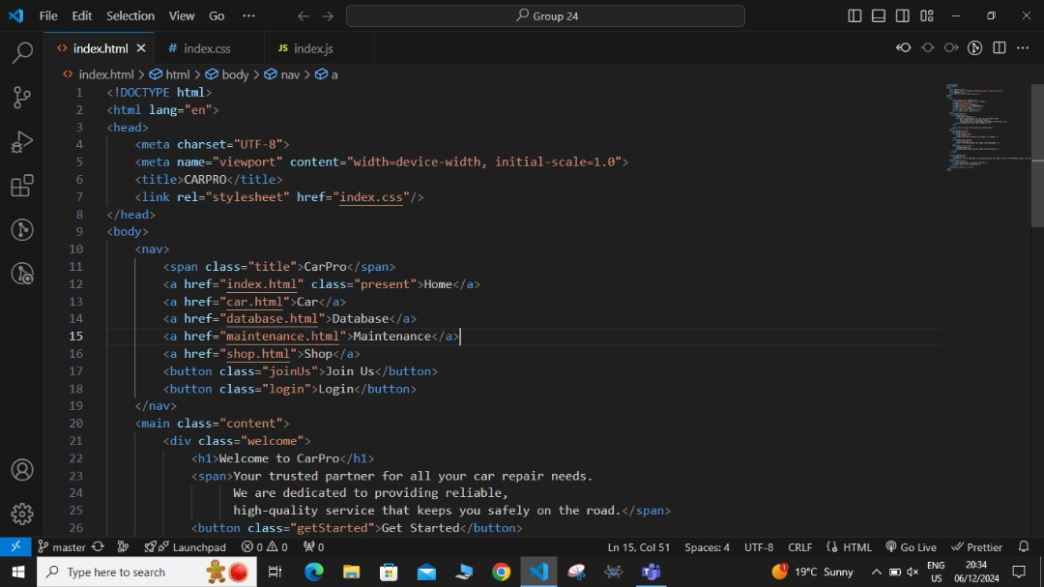
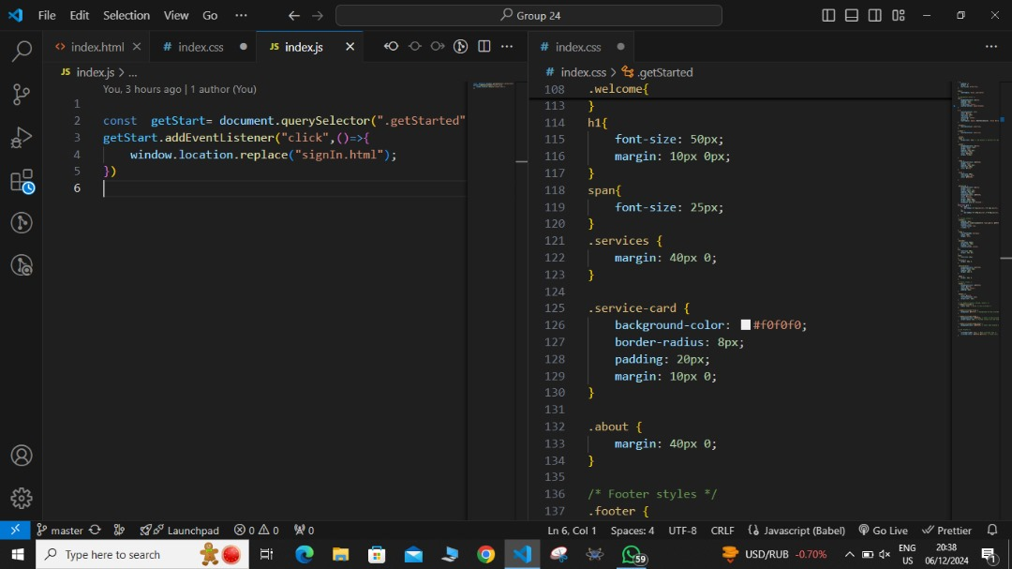
BUILDING OF THE CODE
The title and various menus(Home, car, database mataintenance etc) and buttons of the homepage was written in html
While writing the code we made sure to make use of the debugging tools in VS Code to help us identify any bug in our code to ease the debugging process.
PUSHING THE CODE INTO A GIT BRANCH
SAVING AND DEPLOYMENT

Slide 4
BUILDING OF THE CODE
The styling of the home page was done using CSS
PUSHING THE CODE INTO A GIT BRANCH
SAVING AND DEPLOYMENT

Slide 5
BUILDING OF THE CODE
And JavaScript to add interactivity, dynamic contents and to improve user friendlyness by combining it with HTML and CSS
PUSHING THE CODE INTO A GIT BRANCH
SAVING AND DEPLOYMENT

Slide 6
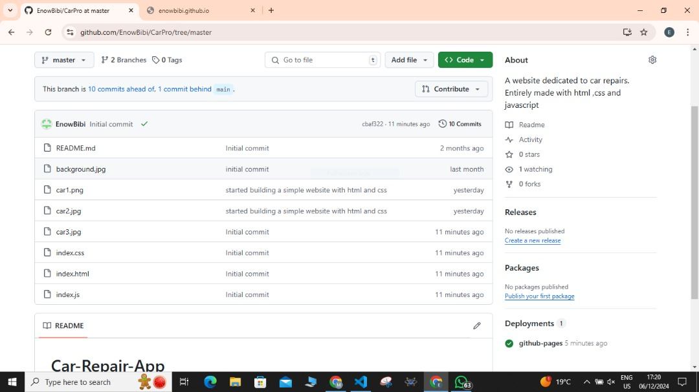
PUSHING THE CODE INTO THE GIT BRANCH
The code was then pushed to the master branch of our Github repository
We the navigated to the setting tab to find pages
Since the page was a public repository, it was easy for us to create the Github page for this code
BUILDING OF THE CODE
SAVING AND DEPLOYMENT

Slide 7
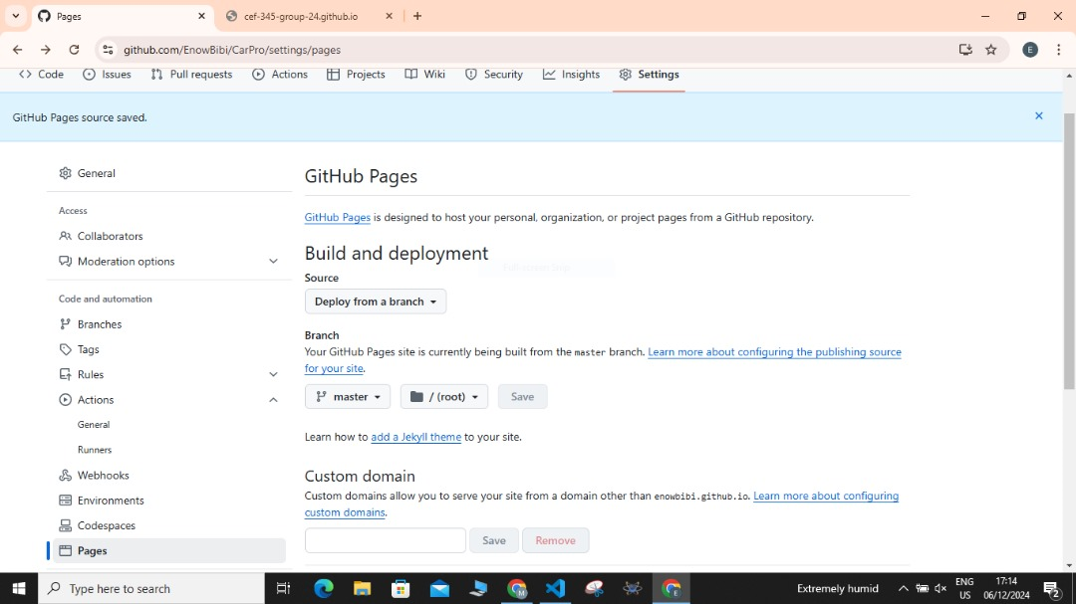
SAVING AND DEPLOYMENT
We then had to deploy the code from our master branch and saved the work
PUSHING THE CODE INTO THE GIT BRANCH
BUILDING OF THE CODE

Slide 8
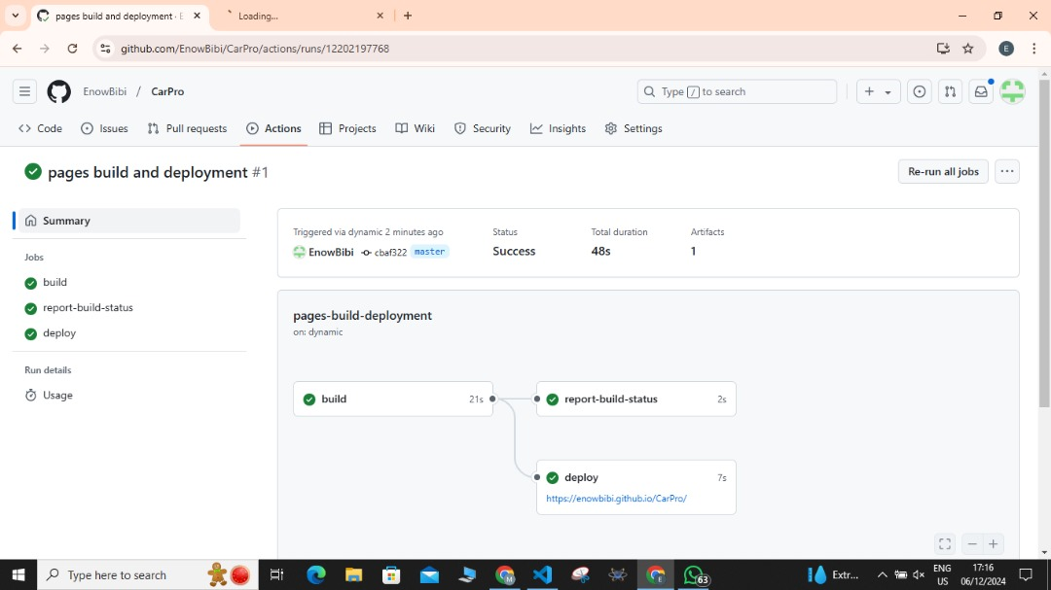
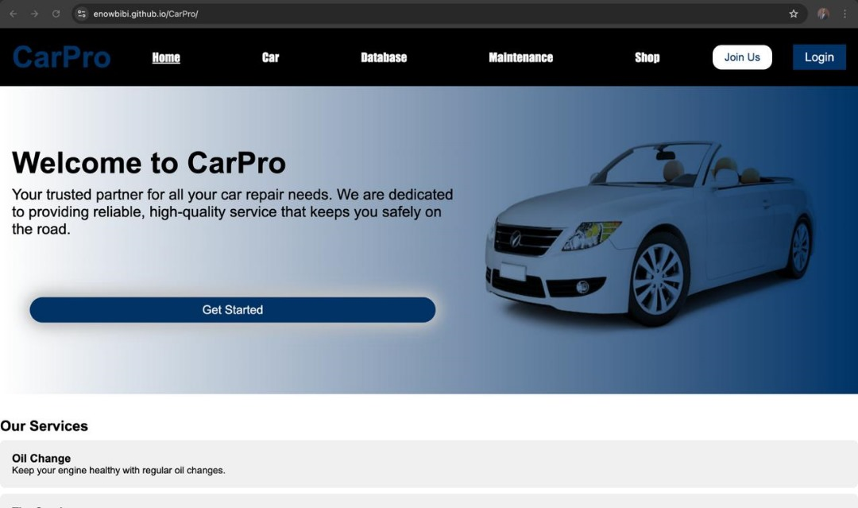
SAVING AND DEPLOYMENT
A link was then generated once we saved our.
This link will automatically direct us to our webpage once we clicked on it.
PUSHING THE CODE INTO THE GIT BRANCH
BUILDING OF THE CODE

Slide 9
SAVING AND DEPLOYMENT
This is the final look at the home page of the CARPRO website
PUSHING THE CODE INTO THE GIT BRANCH
BUILDING OF THE CODE

Slide 10

THANK YOU FOR YOUR ATTENTION

